Slide 3
FACTOR 101

Slide 4
AGENDA
About FACTOR
Getting Started
Our Programs
Artist Rating System
Tips for Success
Resources

Slide 5
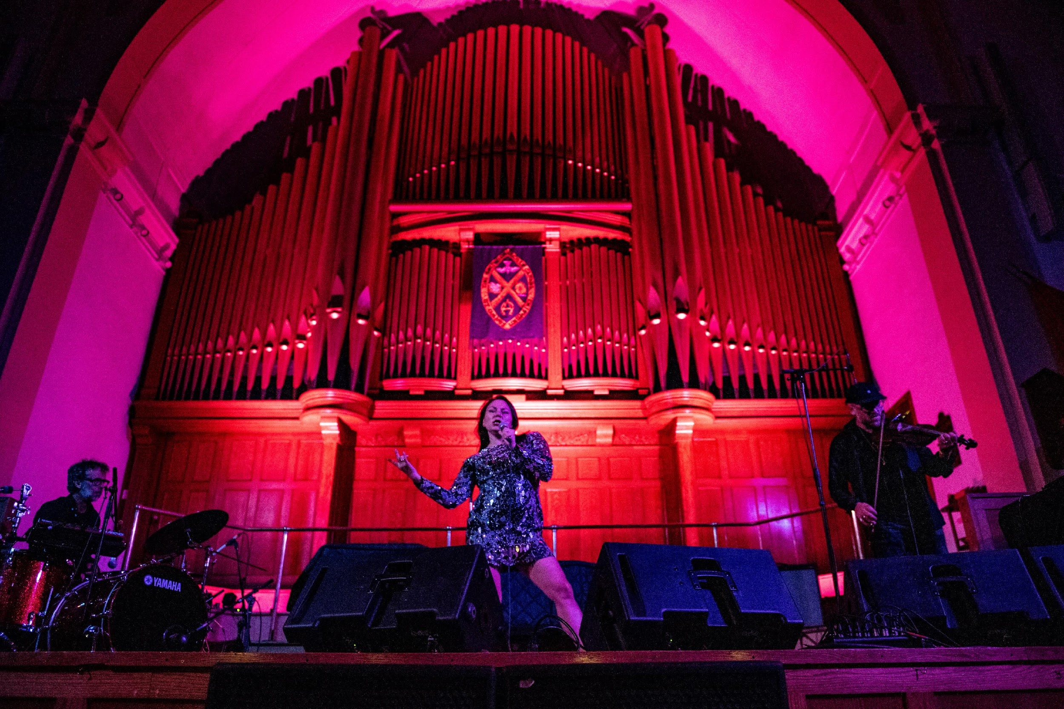
Our Mandate
The Foundation Assisting Canadian Talent on Recordings (FACTOR) gives grants to Canadian musicians and music companies to make and promote Canadian sound recordings and strengthen the Canadian music industry.
Up+Downtown Music and Arts Festival 2018. Photo credit: Eric Kozakiewicz

Slide 6
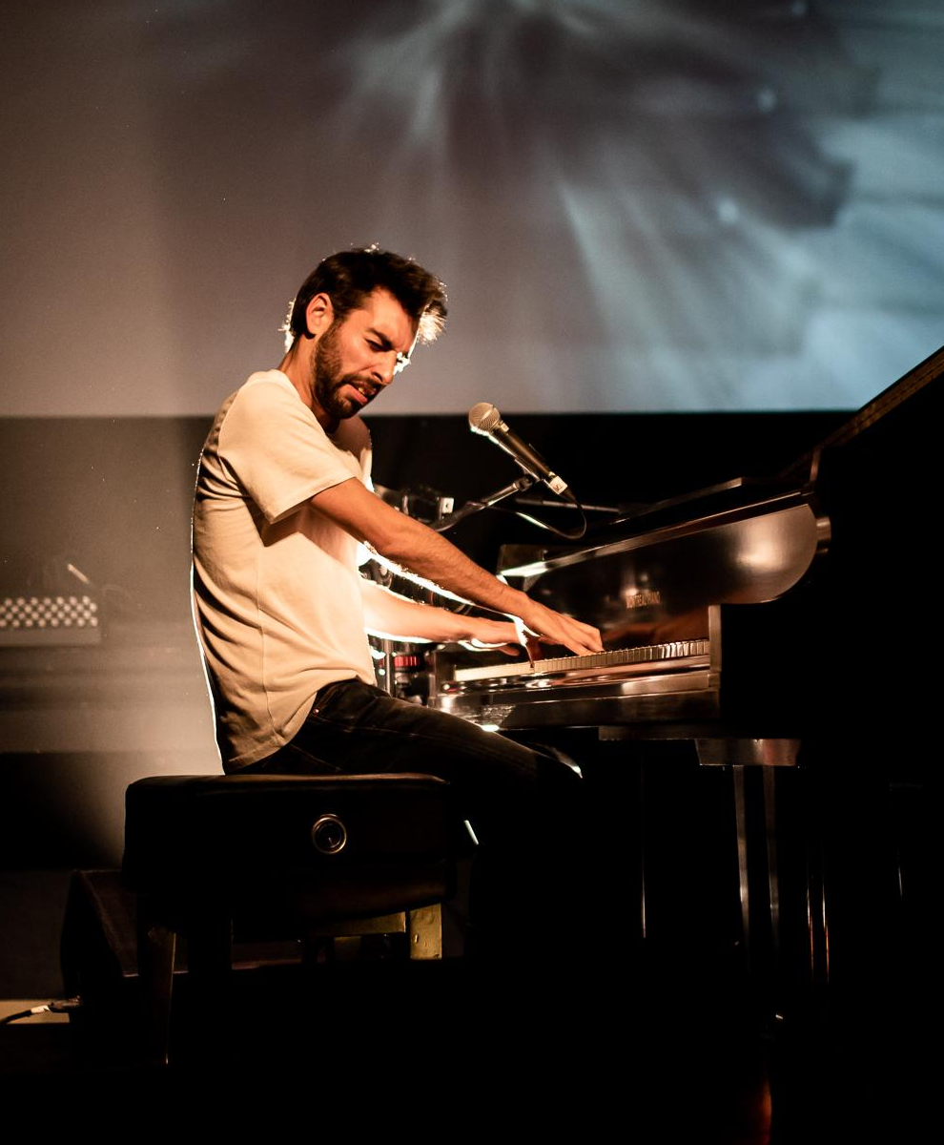
ANNUAL BUDGET
Funding for FACTOR is provided by the Government of Canada through the Canada Music Fund and by Canada’s private radio broadcasters.
Revenue from contributions - $20 million.
Paid out in grants in 18-19: $19.5 million.
PROGRAMS SUPPORT
Canadian artists and music companies.
Projects in any language other than French.
FUNDING
Project-based - accessed through various programs for sound recording, marketing, video, touring, showcase, and radio marketing.
POP Montreal 2018. Photo credit: Louis Longpre

Slide 7
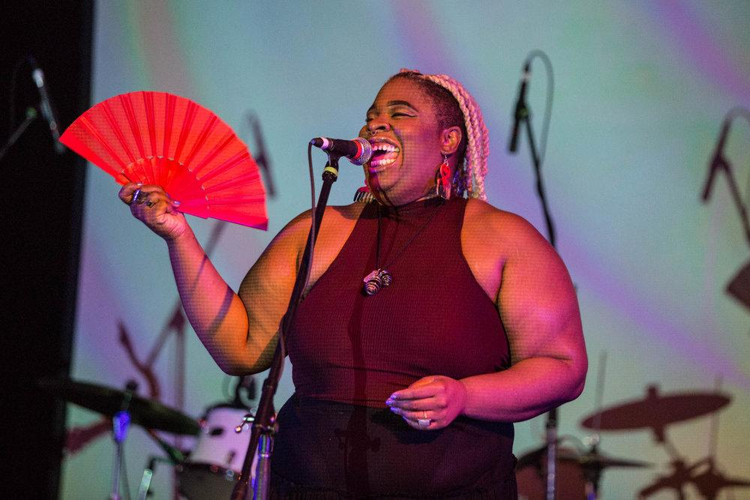
Diversity & Inclusion
FACTOR is committed to reflecting the diversity of the Canadian population in its programs and operations. We are committed to ensuring universal access to all funds and services, including all musical expressions and talent. We will also in our work encourage these values of diversity and inclusiveness within the broader Canadian music sector.
Venus Fest 2018. Photo credit: Jennifer Hyc

Slide 8
GETTING STARTED
ELIGIBILITY
You or at least half of your band members must be Canadian citizens or permanent residents of Canada.
You and your bandmates will need to have one of the following:
Canadian passport
Birth certificate in Canada
Canadian citizenship card
Permanent resident card
SCIS card (Secure Certificate of Indian Status)
Haviah Mighty. Photo credit: KC Creative

Slide 9
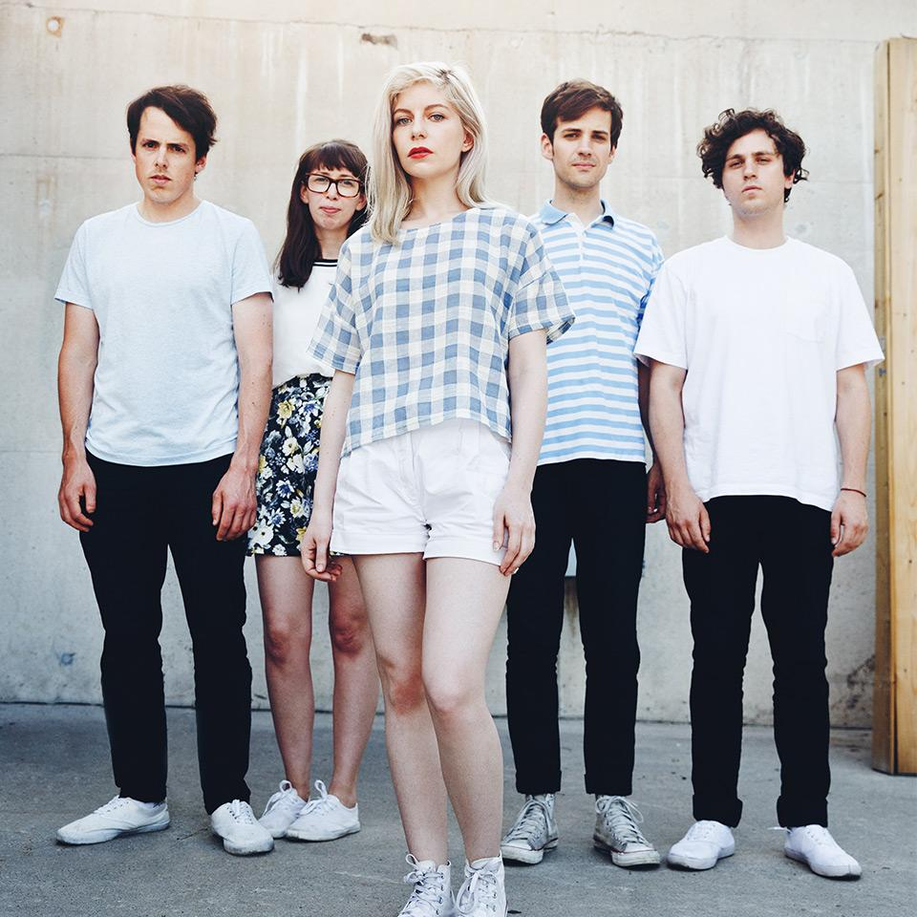
PROFILES
USER PROFILE
Log in with your primary email address
Upload proof of Canadian citizenship
Each band member needs to have their own
APPLICANT PROFILE
Primary business activity (in most cases unless you are a company, this will be “artist”)
Used to submit applications and accept funding
This should be the person who is financially responsible for the project
ARTIST PROFILE
Upload a current artist bio
Add all the artist members in your group
Choose the best primary genre for your music
Alvvays. Photo credit: Jess Baumung.

Slide 10
OUR PROGRAMS
ARTIST DEVELOPMENT
JURIED SOUND RECORDING
SHOWCASE

Slide 11
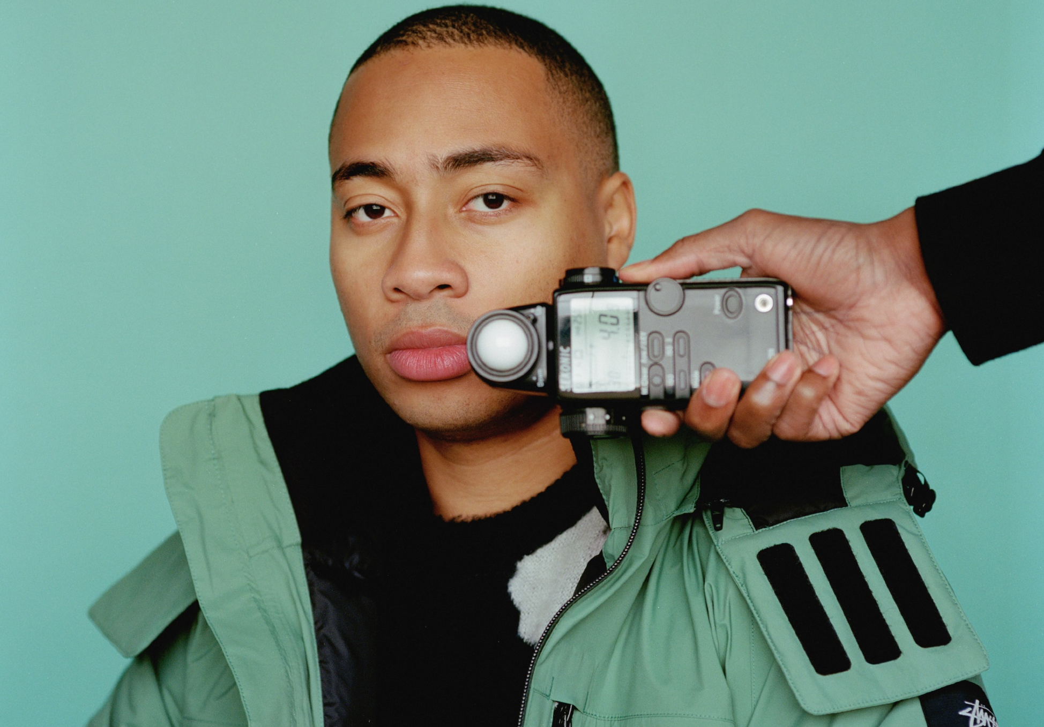
PROGRAM HIGHLIGHTS
May 16th, 2019 2019-2020 Deadlines October 17th, 2019
ARTIST DEVELOPMENT
OVERVIEW:
Funding towards one year of artist development activities such as: sound recording, touring, showcase, video, and marketing.
FACTOR contributes up to 75% of funding up to a maximum of $2,000.
To receive the full $2,000 you must show a total eligible budget of $2,667.
APPLICATION MATERIALS:
A current artist biography
An Artist Development plan (form embedded in the online system)
One MP3 assessment track
Cadence Weapon. Photo credit: Justin Aranha

Slide 12
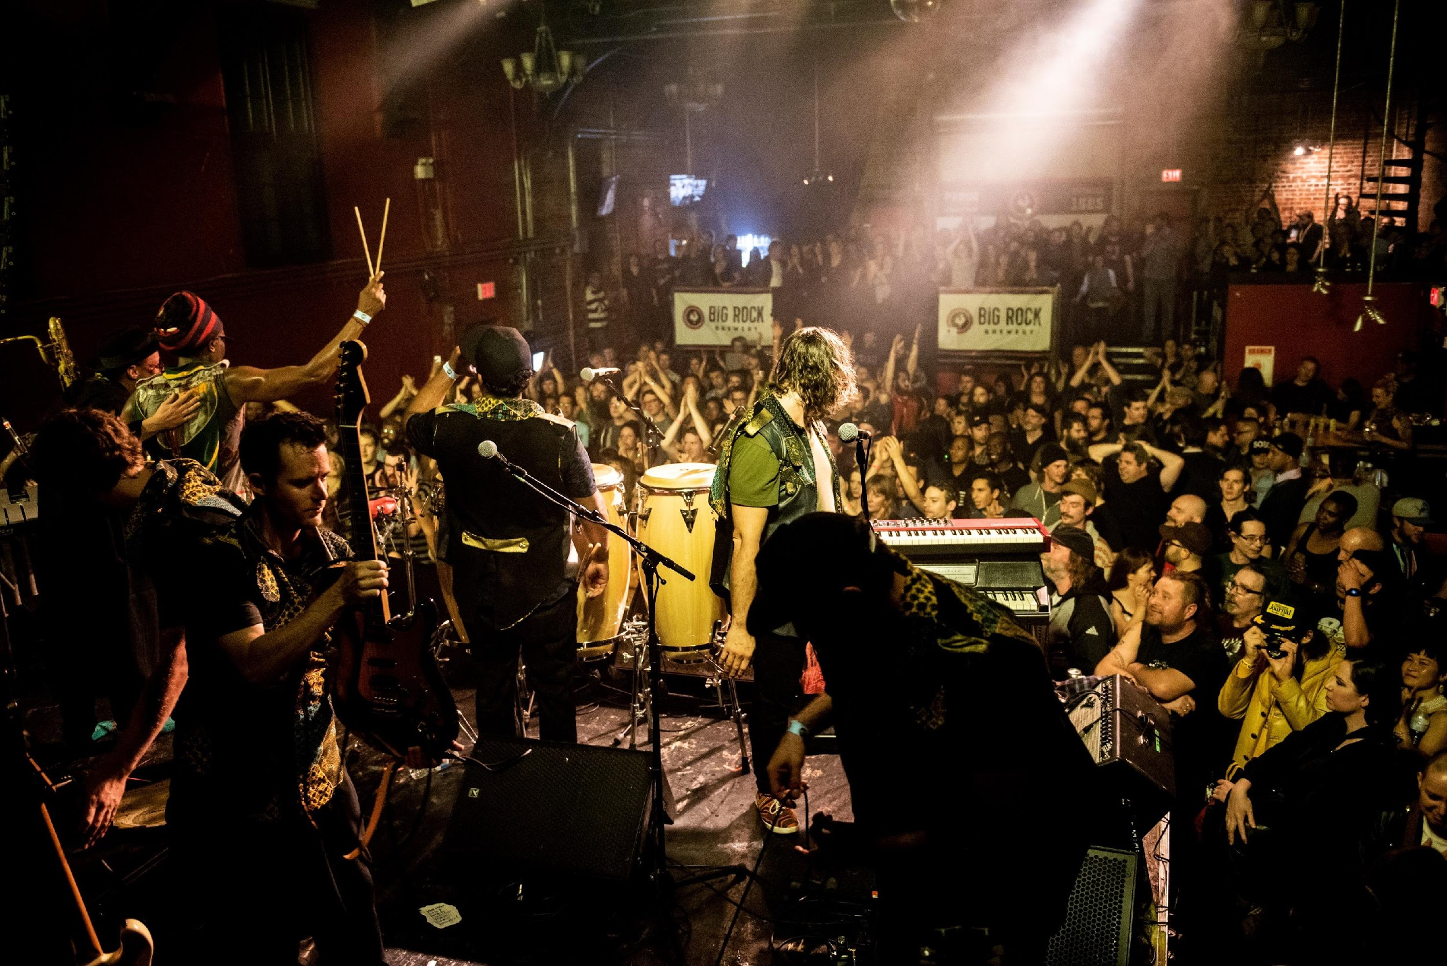
PROGRAM HIGHLIGHTS
May 16th, 2019 2019-2020 Deadlines October 17th, 2019
JURIED SOUND RECORDING
OVERVIEW:
Funding towards the costs of production of a full-length sounding recording and contributes to the marketing and promotion of the album.
Access to: marketing, tour support, showcase, video, and radio marketing.
FACTOR contributes up to 75% of funding up to a maximum of $67,500.
APPLICATION MATERIALS:
Description of goals and expected results
Two previously unreleased MP3 assessment tracks
Description of changes you wish to make to the assessment tracks
Detailed marketing plan
Recording start date
A current artist biography
Up+Downtown Music and Arts Festival. Photo credit: Eric Kozakiewicz

Slide 13
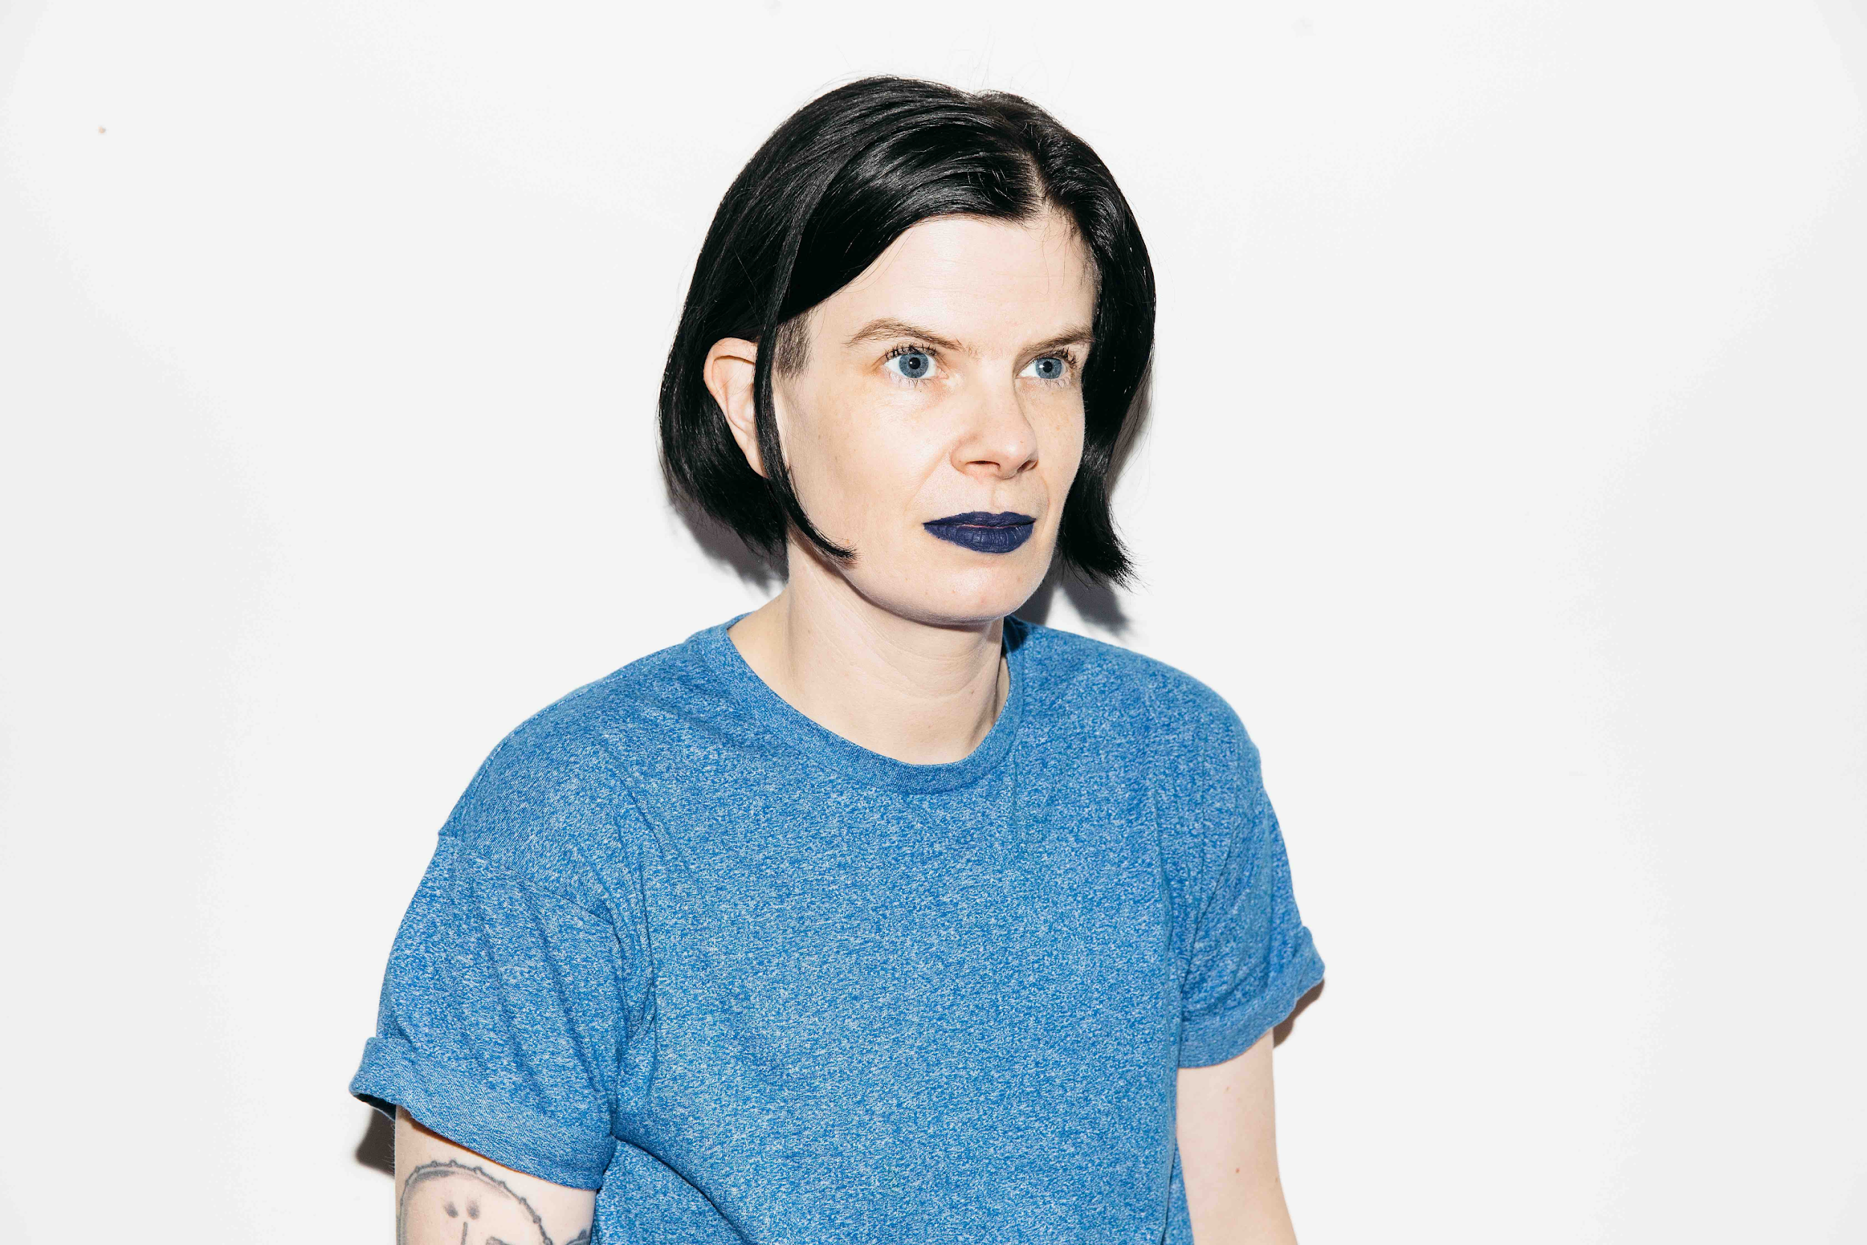
EVALUATION PROCESS
WHO ARE THE JURORS?
Accredited music industry professionals from across the country.
Artists, agents, producers, managers, publicists, radio personalities, promoters, record labels, and more.
Jurors only adjudicate applications from the genre in which they specialize.
Jurors look at the following elements when scoring applications:
Songs
Vocals/Lyrics
Musicality
Marketing Plan
Team
Rae Spoon. Photo credit: Tom Joy

Slide 14
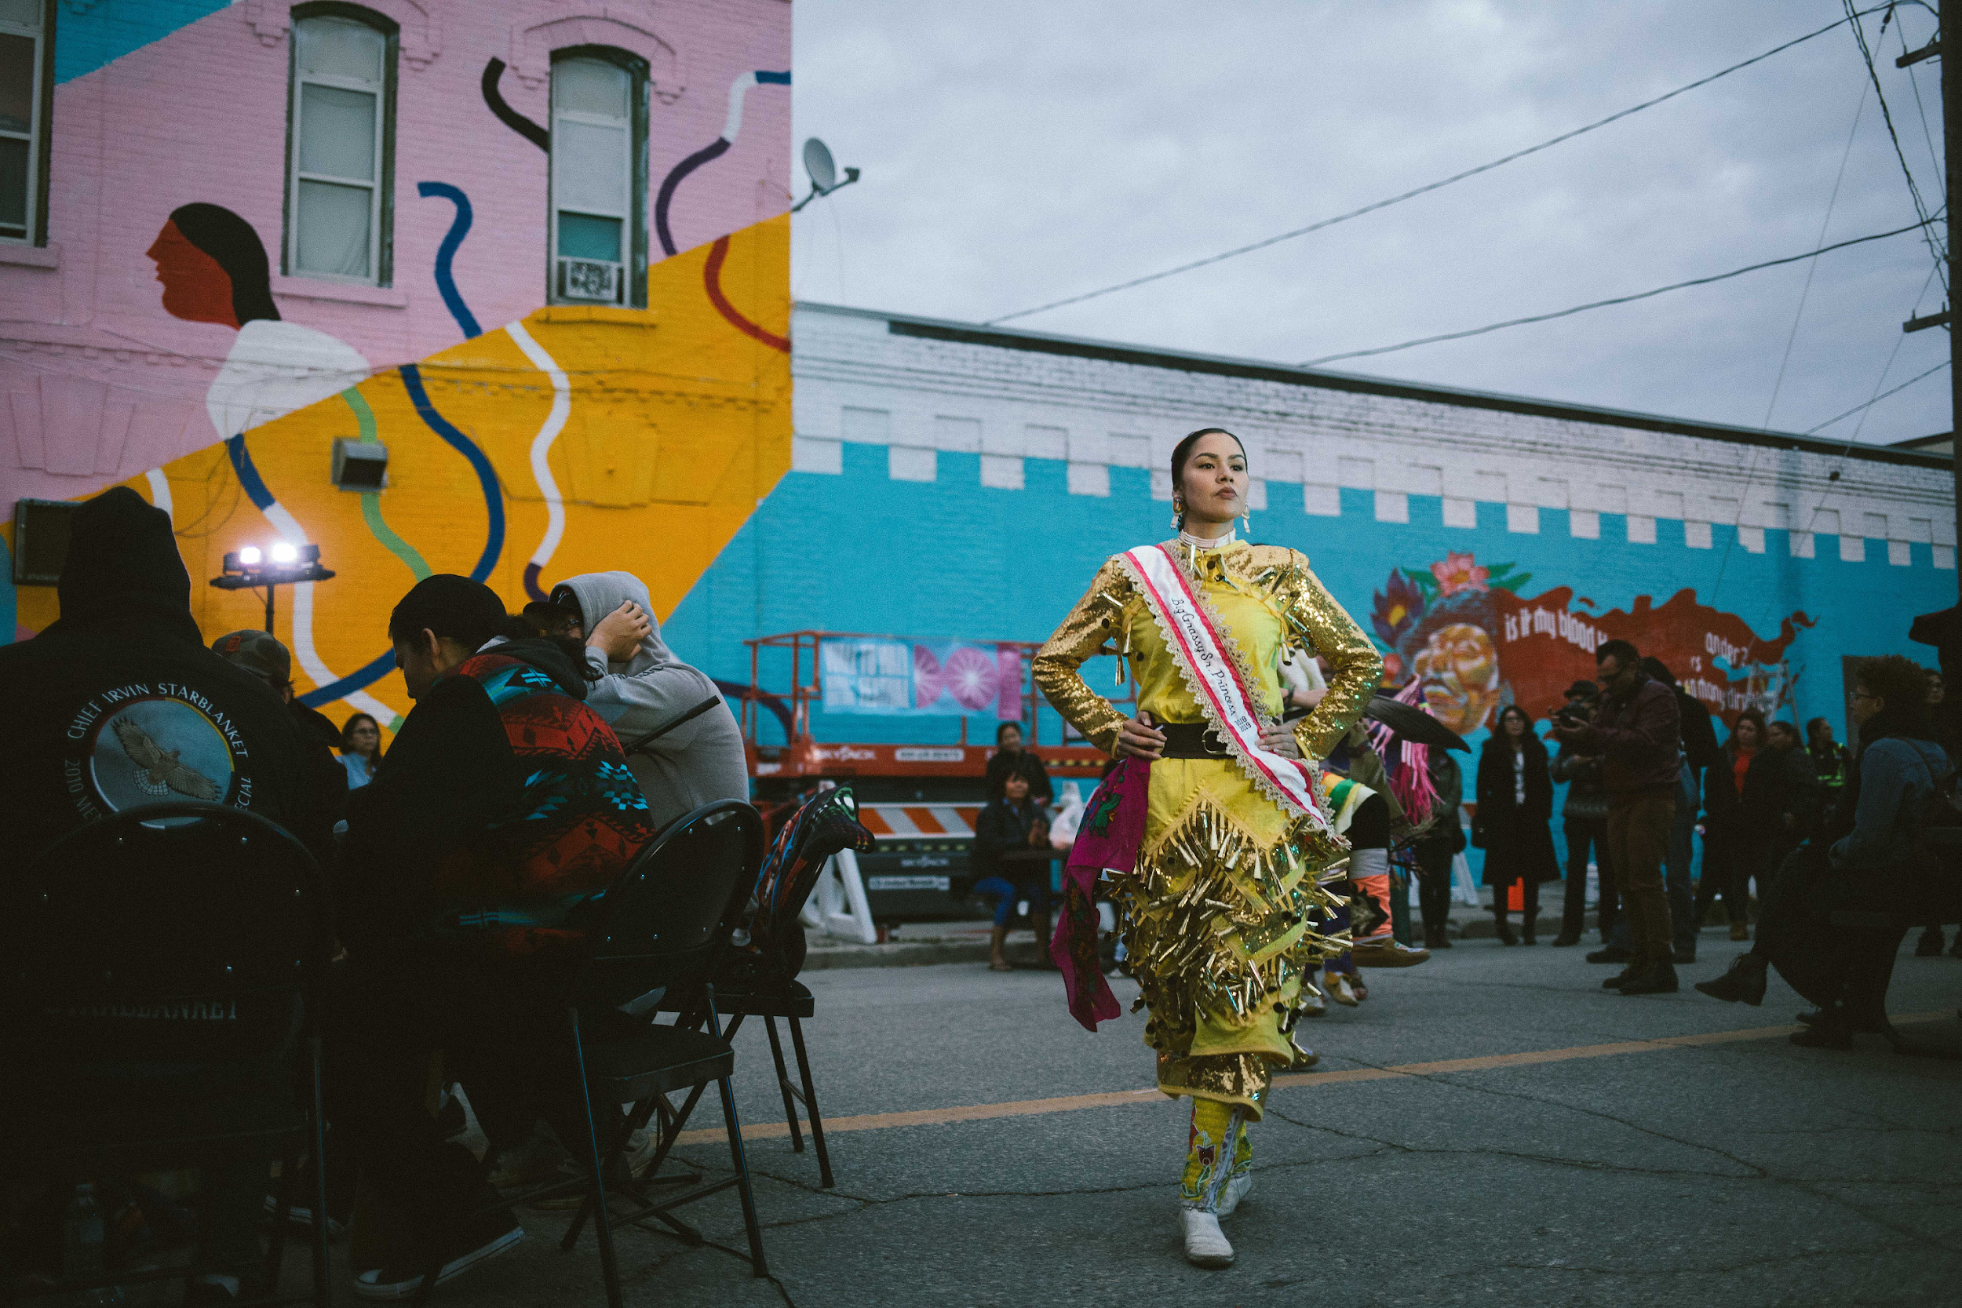
APPLYING TO JURIED PROGRAMS
May 16th, 2019 2019-2020 Deadlines October 17th, 2019
You can apply to one of the juried programs at one of the two deadlines during the year.
You cannot apply to two deadlines in a row.
For each program, the top 20 applications that do not receive funding will be allowed to reapply for the next deadline without waiting a full 12 months.
Before each deadline, there is a three-month window during which applications can be created, edited, and submitted.
Wall-to-Wall 2018. Photo credit: Jen Doerksen

Slide 15
JURIED PROGRAMS TIPS
Propose plans that are specific and achievable
Consider your reader
Choose genre wisely
Read juror comments
Proofread
Venus Fest 2018. Photo credit: Jennifer Hyc

Slide 16
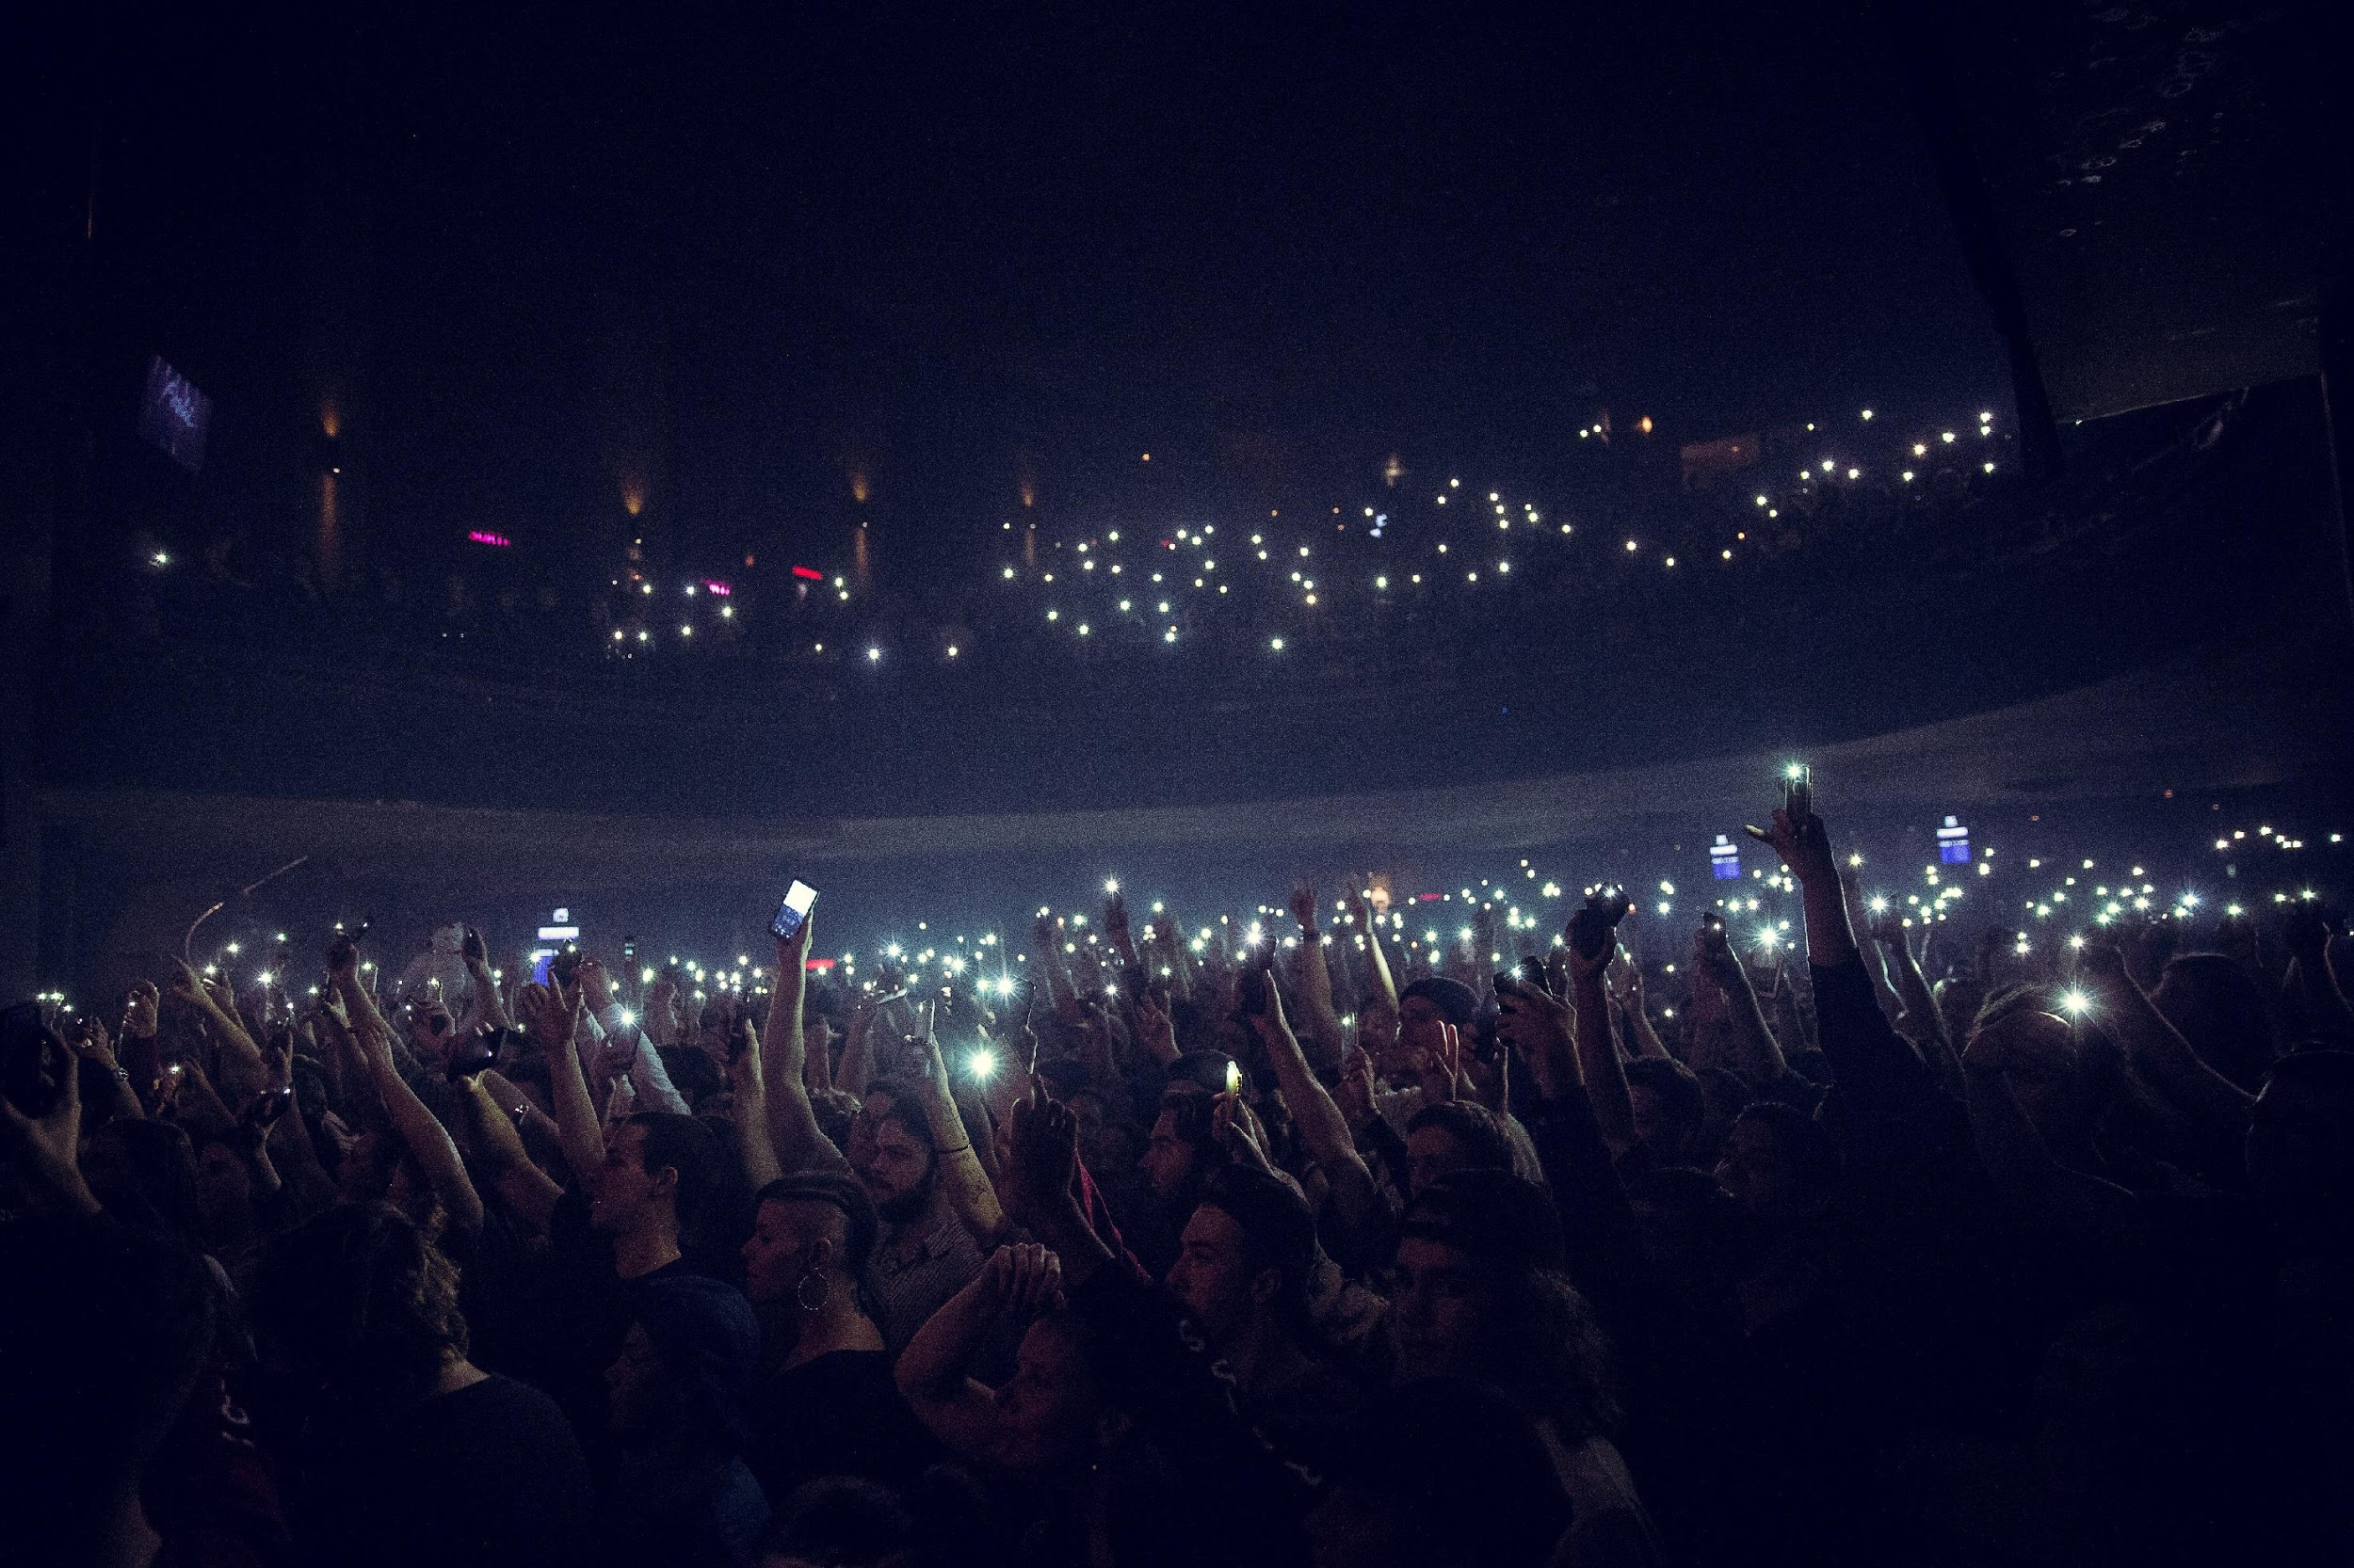
ARTIST RATING SYSTEM
Your artist rating determines which programs you can apply to.
General
Artist 2
Artist 3
Artist profiles are reviewed twice a year:
- End of August
- End of February
POP Montreal 2018. Photo credit: Ranko-Bobusic

Slide 17
PROGRAM HIGHLIGHTS
SHOWCASE
Rolling. Apply a least one calendar day before you depart!
2019-2020 Deadlines
OVERVIEW:
Supports travel costs for artists to play recognized showcases for targeted audiences of potential music industry partners like booking agents, managers and record labels (rather than for the general public).
FACTOR contributes up to 75% of funding up to a maximum of $7,500 on international showcases.
APPLICATION MATERIALS:
An invitation to play an upcoming showcase.
Either a current release (released no more than 24 months before you submit your application) or an upcoming release (to be released within six months of the showcase date).
A list of industry professionals with name, title, and company that you or your team have invited to the showcase.
Femme Wave 2018. Photo credit: Elizabeth Cameron

Slide 18
TIPS FOR SUCCESS
ALL PROGRAMS
Understand your funder
Start preparing early, especially if it's your first time applying
Read the Program Guidelines
Connect with your Project Coordinator
If someone else is writing your grant, make sure you read it
Talk to previous recipients / search the FACTORfunded list
Understand public funding policy
APPROVED PROJECTS
Keep track of receipts, and avoid using cash
Know the logo and acknowledgment requirements
If plans change, contact your Project Coordinator
Weaves. Photo credit: Brendan George Ko

Slide 19
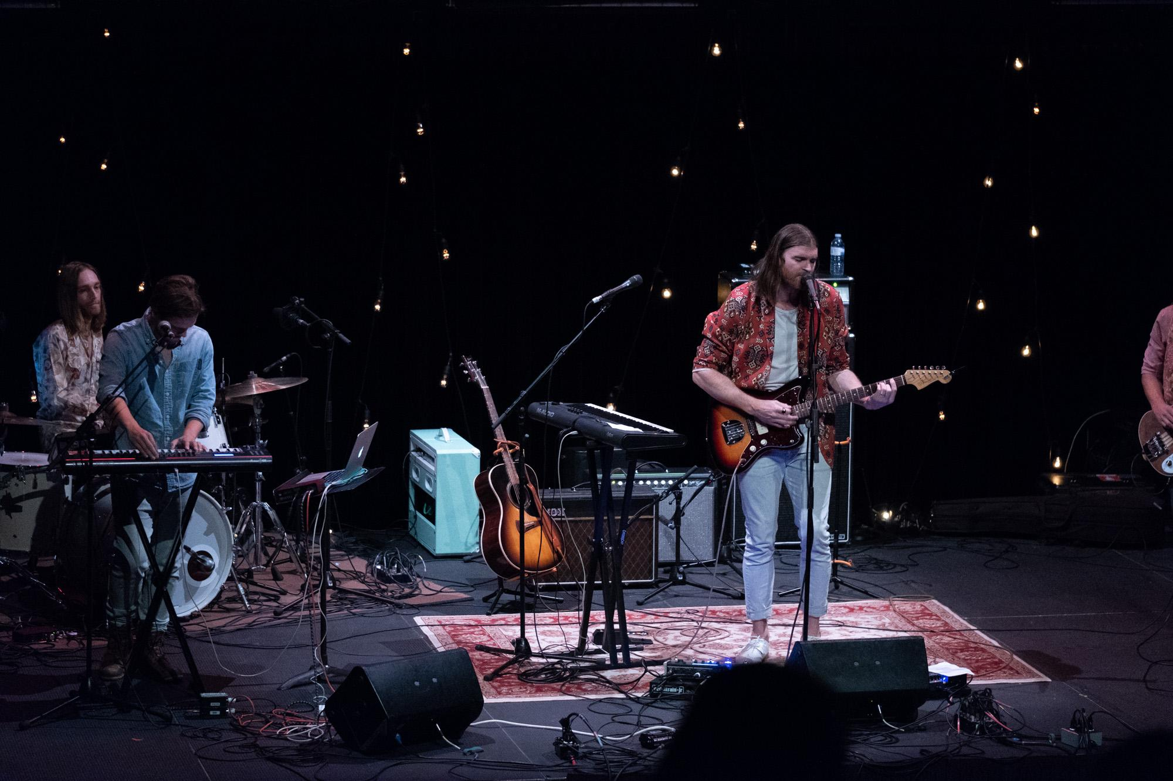
TIPS FOR SUCCESS
RESOURCES
FACTOR website: www.factor.ca
How to guides, step by step instructions, forms and templates.
Program Guidelines
Specific guidelines for each program.
Annual Reports
Database of recipients
Sort by program, province/territory, date, etc.
Regional Education Coordinators
Your Project Coordinator!
Business Policies
VIFF 2018. Photo credit: Biliana Panic

Slide 20
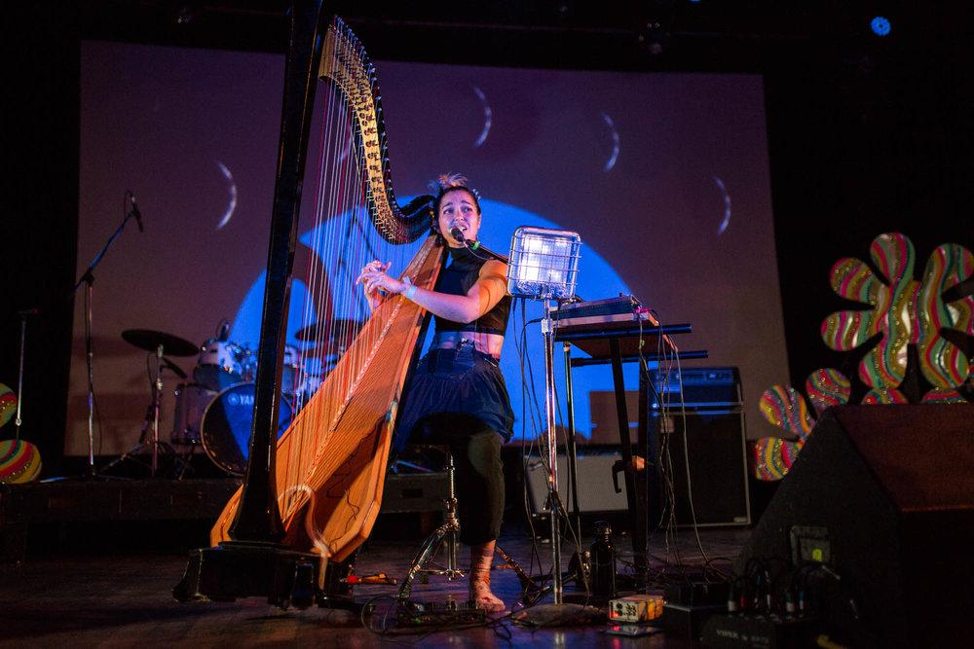
THANK YOU!
Venus Fest 2018. Photo credit: Jennifer Hyc

